Slide 1

Project Seminar on Rented House Management System
Presented By
Pranali V. Kolhe
Guided By
Ass. prof. Ratnesh K. Choudhary
Department of Computer Science & Engineering
S. B. JAIN INSTITUTE OF TECHNOLOGY MANAGEMENT AND RESEARCH,NAGPUR
An Autonomous Institute, Affiliated to RTMNU, Nagpur

Slide 2
Contents
Problem Statement & Objectives
Introduction
Literature Survey
System Design
Developed Modules
Modules Description
Screenshots
Technology Used
Advantages & Applications
Conclusion
Future scope
References
S. B. Jain Institute of Technology Management and Research
2

Slide 3
Problem Statement & Objectives
Problem Statement
Over the years landlords/property managers have had a problem in maintaining and managing their customers and their own records. data increase day by day. Storing and maintaining all data manually is very difficult . currently most landlords/property managers use the manual system in recording and maintaining their property and customers data. In manual way, data is recorded an the books/papers which may easily get damaged leading to loss of data. Potential of data loss or damage is very high because data is stored on tangible files. Lack of these crucial requirements makes management of the tenants and houses very difficult as some tenants may end up not paying rent.
Objectives
To Provide Advance Search facility to user.
To Reduce affords of user.
To Provide full satisfaction to user.
To fulfill the requirement of the renter.
To provide the detail of the costumer and the house to the renter.
S. B. Jain Institute of Technology Management and research
3

Slide 4
Introduction
Rental house management has become important factor in modern society hence the need to have a rental house management system. Housing has a certain importance to quality of life with considerable economic , social, cultural and personal significance. Thought a country’s national prosperity is usually measured in economic terms, increasing wealth is of diminished value unless all can share its benefits and if the growing wealth is not used to redress growing social deficiencies, one of which is housing . Housing plays a huge role in revitalizing economic growth in any country, with shelter being among key indicator of development.
The focus of this research project is basically managing housing for low income, medium and high incomes households or what is commonly known as affordable housing. „Affordable‟ is a term used to describe individuals‟ capability to pay for certain products or services because their income is enough to do so. Although the term „affordable housing‟ is often applied to rental housing; that is within the financial means of those in the lower income ranges of a geographical area, the concept is applicable to both middle and high income individuals. Most families choose to rent houses based on their income and family situations; unfortunately, there may not be enough good quality rental housing for these families
S. B. Jain Institute of Technology Management and research
4

Slide 5
Literature Survey
Websites / Paper / Article/book | Reviews / Findings
Coding classes –for young minds- coding learning platform | A Range of online coding courses that makes coding accessible to kids & teenagers. Multiple student projects.
Let us c++ | This book help us to learn detail of c++ and the uses of particular library functions ,header file etc.
S. B. Jain Institute of Technology Management and research
5

Slide 6
System Design: Flowchart
start
registration
login
custdetail
House detail
Rent house
pass
Customer no
House no
Given
user
name
hname
Permenent add
No room
vacant
Email adder
colour
exit
Phone no
addr
S. B. Jain Institute of Technology Management and research
6

Slide 7
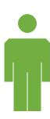
Use case Diagram
Home
Login
Search available house
Customer detail
House detail
General detail
Log out
S. B. Jain Institute of Technology Management and research
7

Slide 8
Developed Modules
Please select option
Select any one option for given
Login
Login the page by using correct user name and password
Customer detail
Fill the detail of the customer correctly
House detail
Fill the house detail as per your requirement
Rent house
Rent the house as per your choose
S. B. Jain Institute of Technology Management and research
8

Slide 9
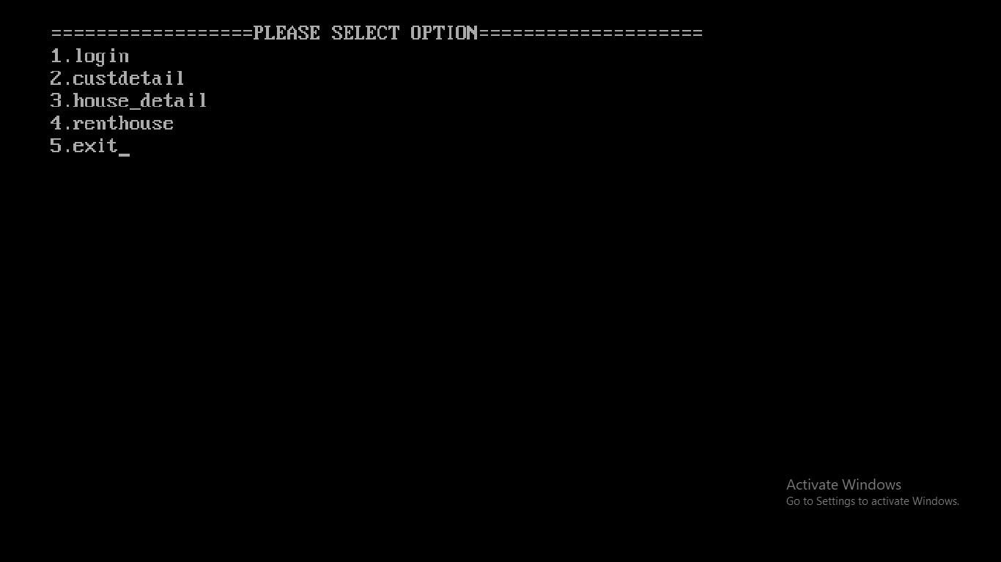
Screen Shots
Please select option
S. B. Jain Institute of Technology Management and research
9

Slide 10
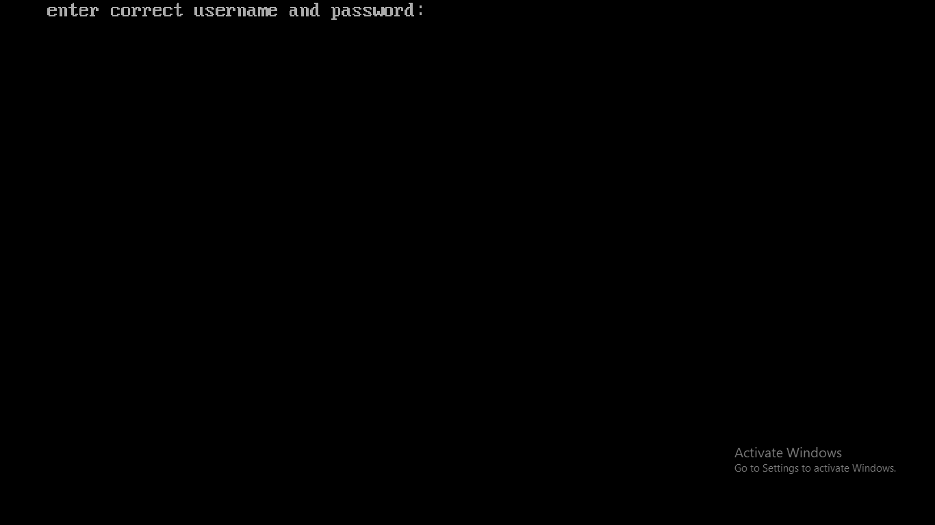
Login

Slide 11
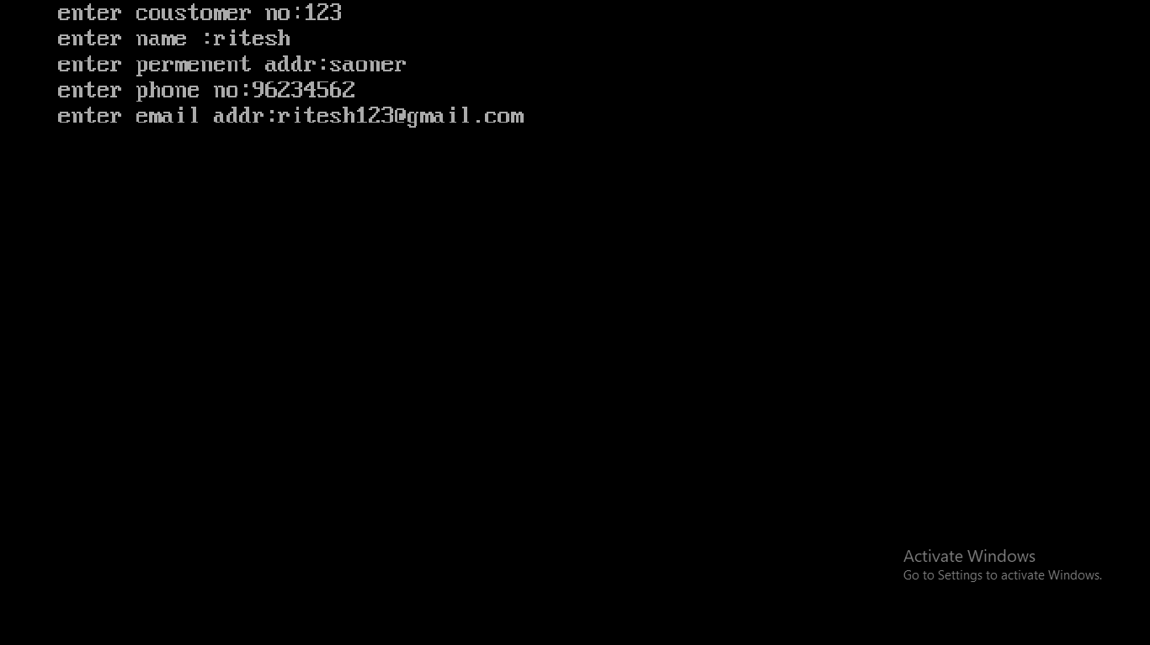
Customer detail

Slide 12
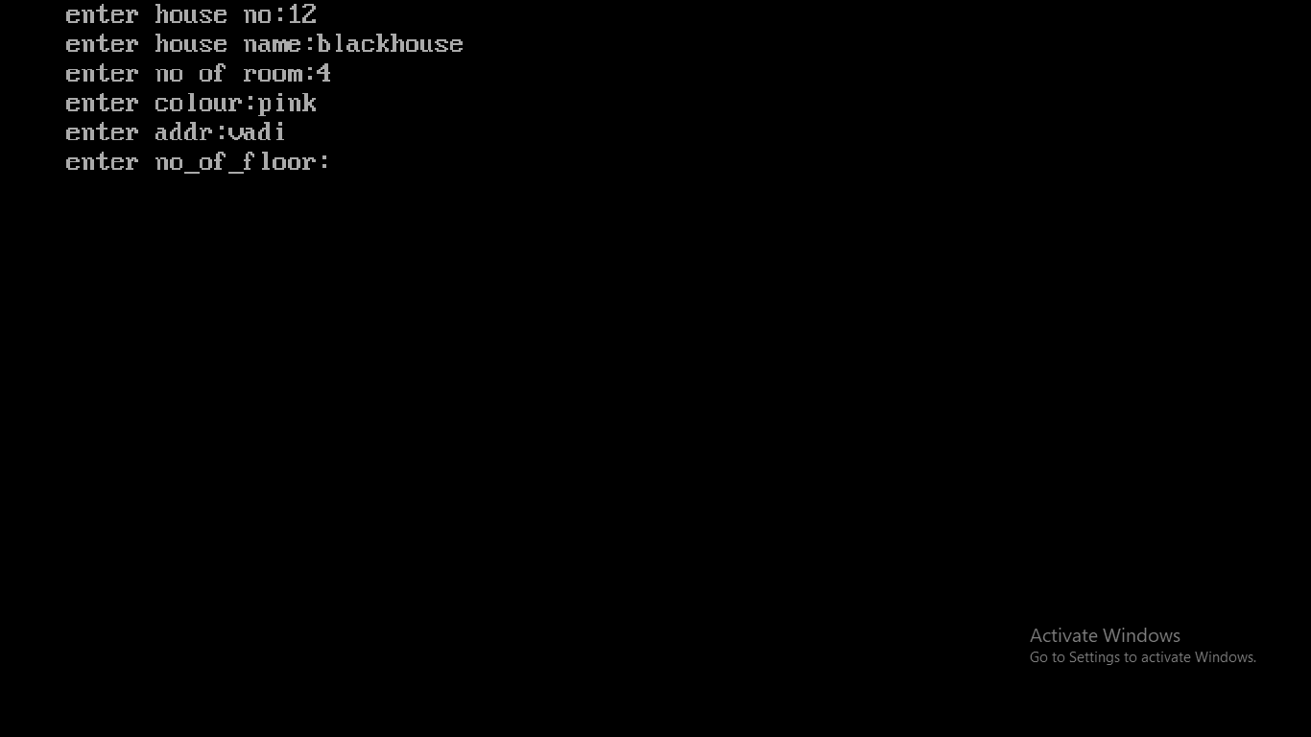
House detail

Slide 13
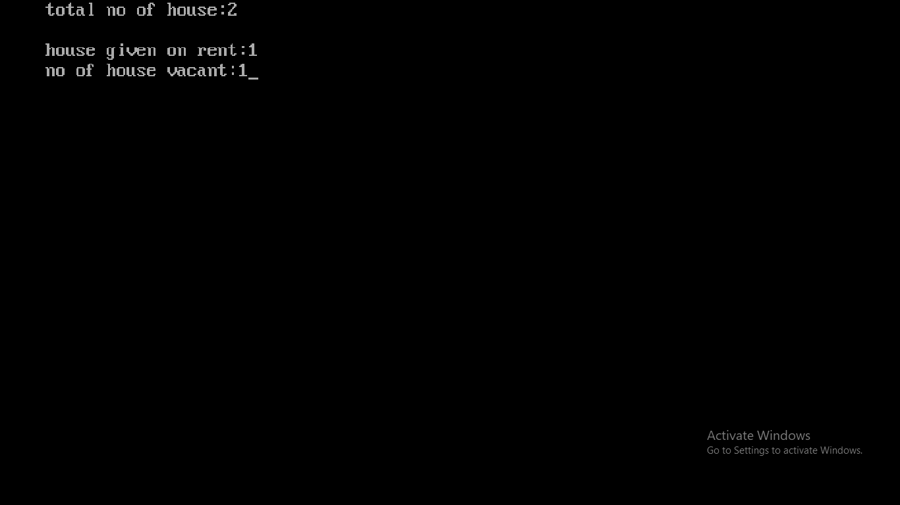
Rent house

Slide 14
Technology Used
Front End : c++
IDE: turboc++
Code designed: Rented house management
S. B. Jain Institute of Technology Management and research
14

Slide 15
Hardware Details
the names of hardware used in your project.
Computer
Keyboard
Mouse
Ram
S. B. Jain Institute of Technology Management and research
15

Slide 16
Advantages
1.Eliminate paper-based process
2. Intuitive & user-friendly
3. Customization and flexibility
4. Optimal resource allocation
5. Highly secure
S. B. Jain Institute of Technology Management and research
16

Slide 17
APPLICATION
To analyze the manual system for managing rental houses, outline its flaws and determine the significance of the digital system by the end of August.
To develop more than 50% of the rental house management system which will aim to digitalize the manual management of the rental houses for the landlords and tenants by the end of August.
To reach a significant number of landlords and tenants digitally offering a platform to easily manage their houses and have access to the rental houses respectively by the end of the year.

Slide 18
Conclusion
Effectively resolving the apartment issues is important to the buyer's long-term future, the Rental house management Project will be an important tool for creating rental housing stability by helping tenants speak with greater credibility through initiating and documenting communications and building productive relationships
with sellers. Rental house management project provides buyers of specific housing associations and social. Finally, the goal of the project is to create a better relationship between tenants and a sellers which can be achieved through this project.
S. B. Jain Institute of Technology Management and research
18

Slide 19
Future Scope
In future our project is meant to satisfy the needs of rental house owners. Several user friendly interfaces have also been adopted. This package shall prove to be a powerful in satisfying all the requirements of the users. It is with utmost faith that I present this software to you hoping that it will solve your problems and encourage you to continue appreciating technology because it is meant to change and ease all our work that seems to be very difficult. I don't mean that my project is the best or that I have used the best technology available it just a simple and a humble venture that is easy to understand. In extent we can add GPS system in build and can give live
chat online option to users. This project can also be extended to IOS Platform and several state Database can be included. Could also allow local business to push deals/coupons within a certain geographic area.
S. B. Jain Institute of Technology Management and research
19

Slide 20
REFERENCES
https://learnitanytime.com/6374/what-are-the-advantages-and-disadvantages-of-c++/
Let us c++ book
S. B. Jain Institute of Technology Management and research
20

Slide 21
Thank You

